Slide 1
Error detection
Error detection,
Parity, Internet checksum, CRC.

Slide 2

A simple parity-check code is a single-bit error-detecting
code in which
Note
n = k + 1 with d_{min} = 2.
Even parity (ensures that a codeword has an even number of 1’s) and odd parity (ensures that there are an odd number of 1’s in the codeword)

Slide 3
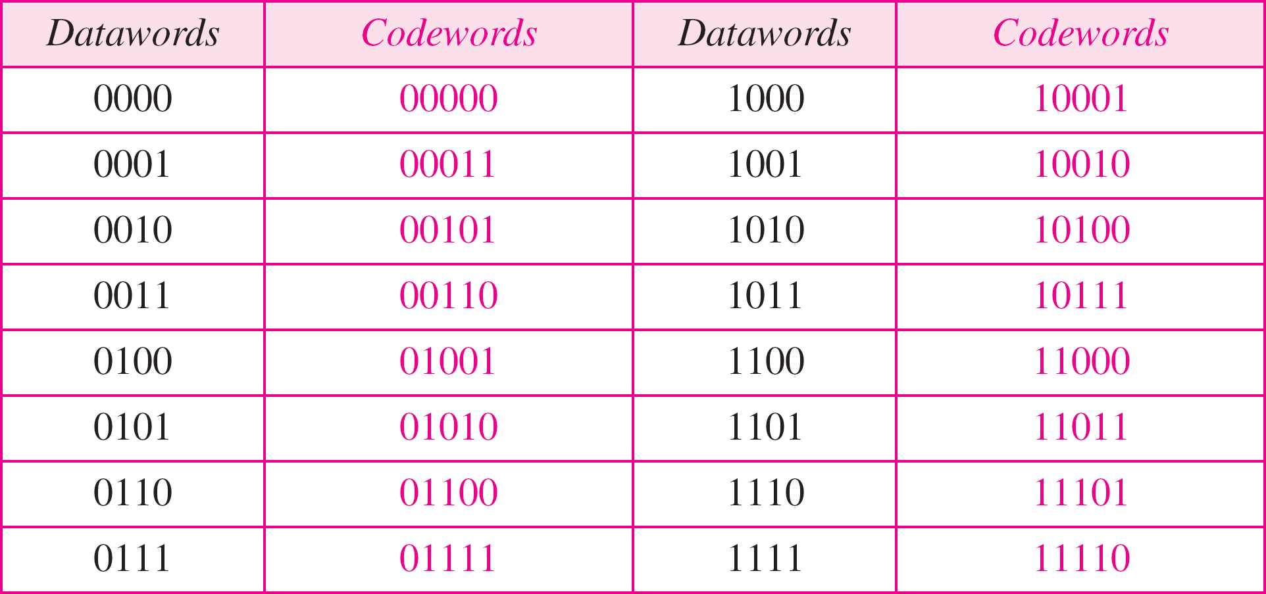
Table Simple parity-check code C(5, 4)

Slide 4
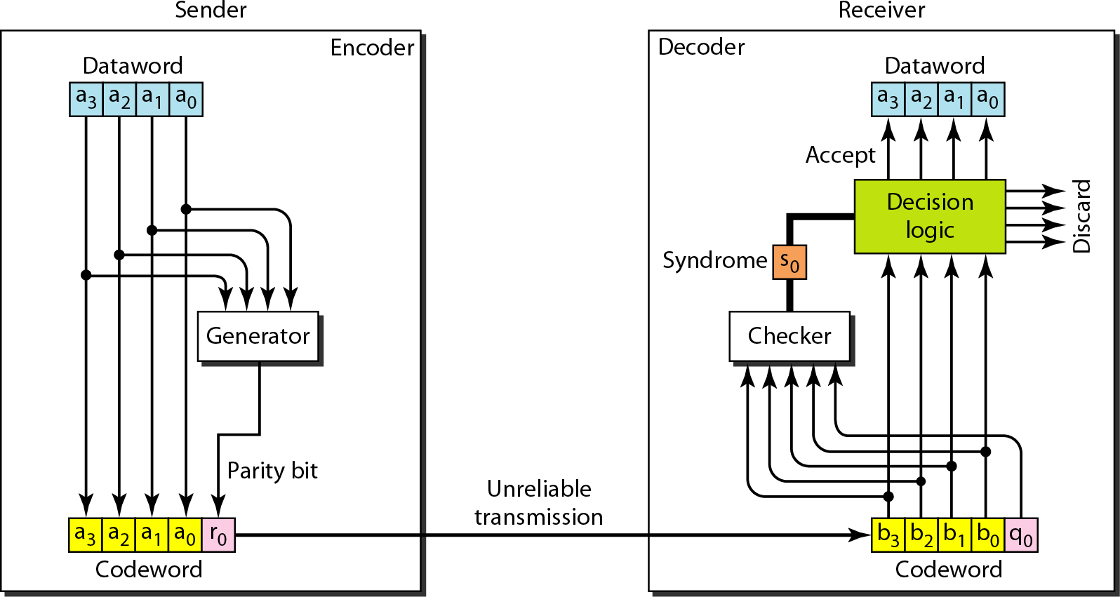
CRC Encoder and decoder for simple parity-check code

Slide 5
Example
Let us look at some transmission scenarios. Assume the sender sends the dataword 1011. The codeword created from this dataword is 10111, which is sent to the receiver. We examine five cases:
No error occurs; the received codeword is 10111. The syndrome is 0. The dataword 1011 is created.
One single-bit error changes a₁ . The received codeword is 10011. The syndrome is 1. No dataword is created.
One single-bit error changes r₀ . The received codeword is 10110. The syndrome is 1. No dataword is created.

Slide 6
Example (continued)
An error changes r₀ and a second error changes a₃ . The received codeword is 00110. The syndrome is 0. The dataword 0011 is created at the receiver. Note that here the dataword is wrongly created due to the syndrome value.
Three bits—a₃, a₂, and a₁—are changed by errors. The received codeword is 01011. The syndrome is 1.
The dataword is not created. This shows that the simple parity check, guaranteed to detect one single error, can also find any odd number of errors.

Slide 7













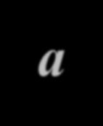

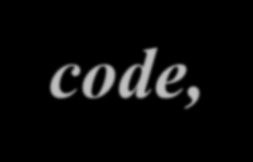





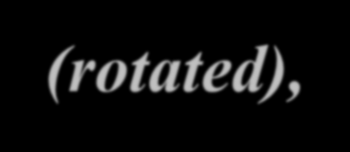





CYCLIC CODES
Cyclic codes are special linear block codes with one extra property. In a cyclic code, if a codeword is cyclically shifted (rotated), the result is another codeword.
Cyclic Redundancy Check>

Slide 8
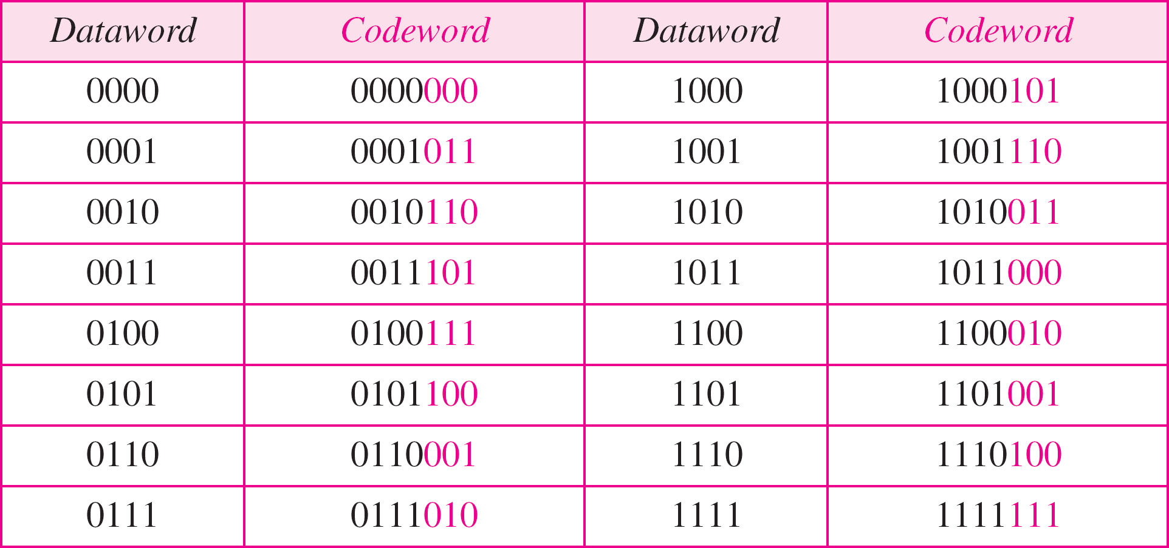
Table 10.6 A CRC code with C(7, 4)

Slide 9
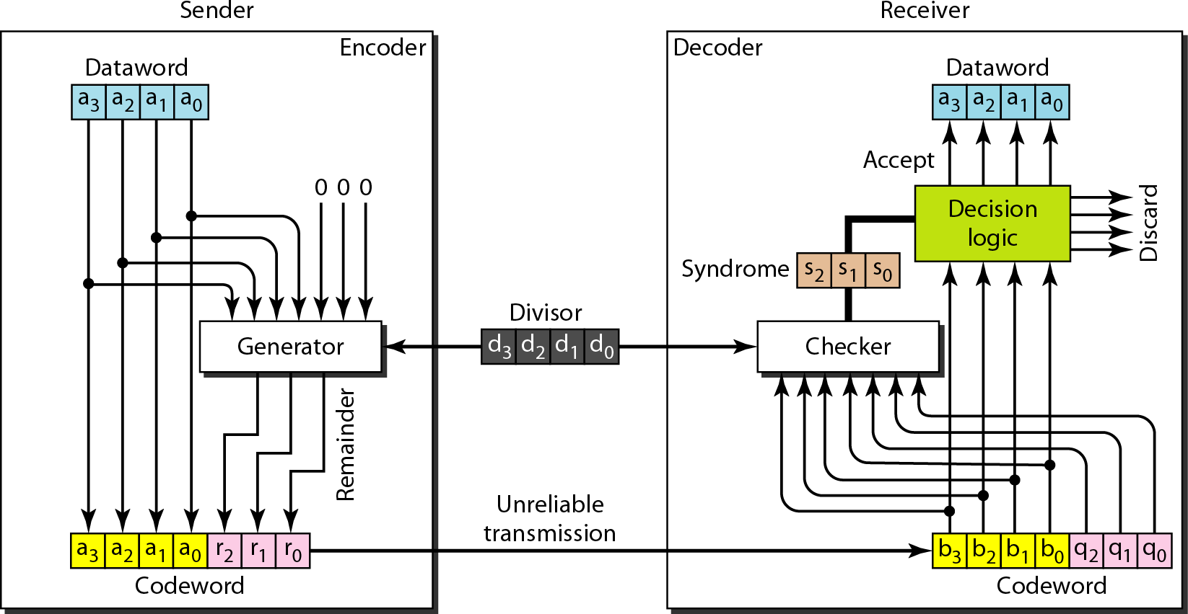
Figure CRC encoder and decoder

Slide 10
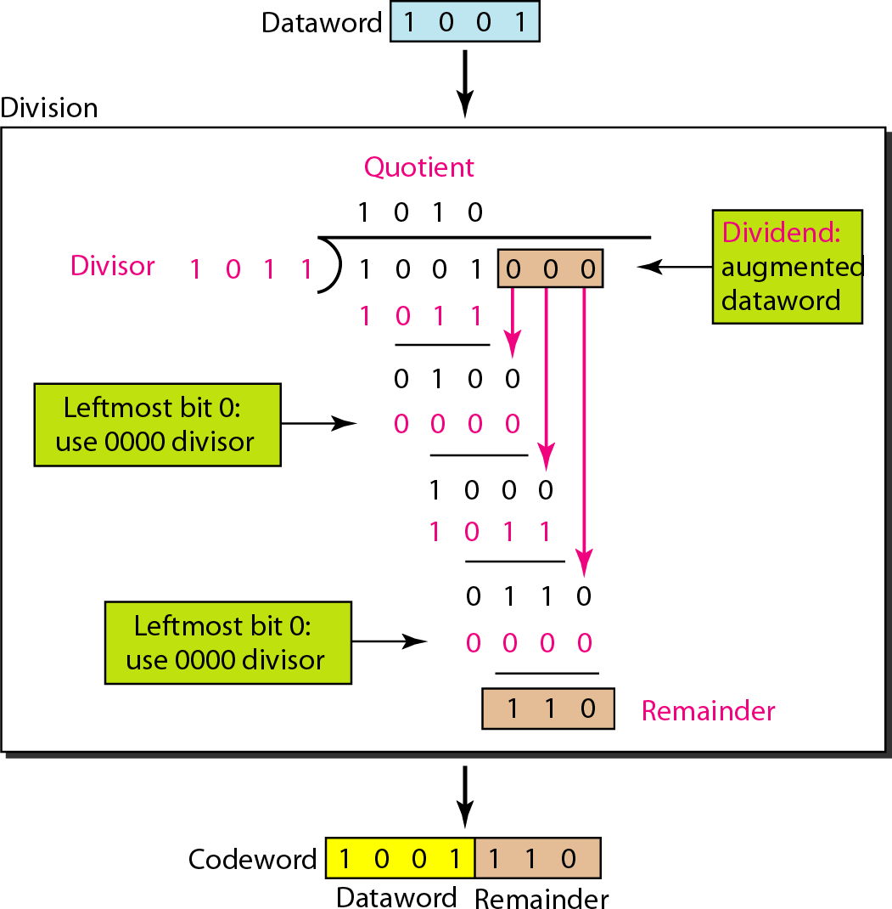
Figure
Division in CRC encoder

Slide 11
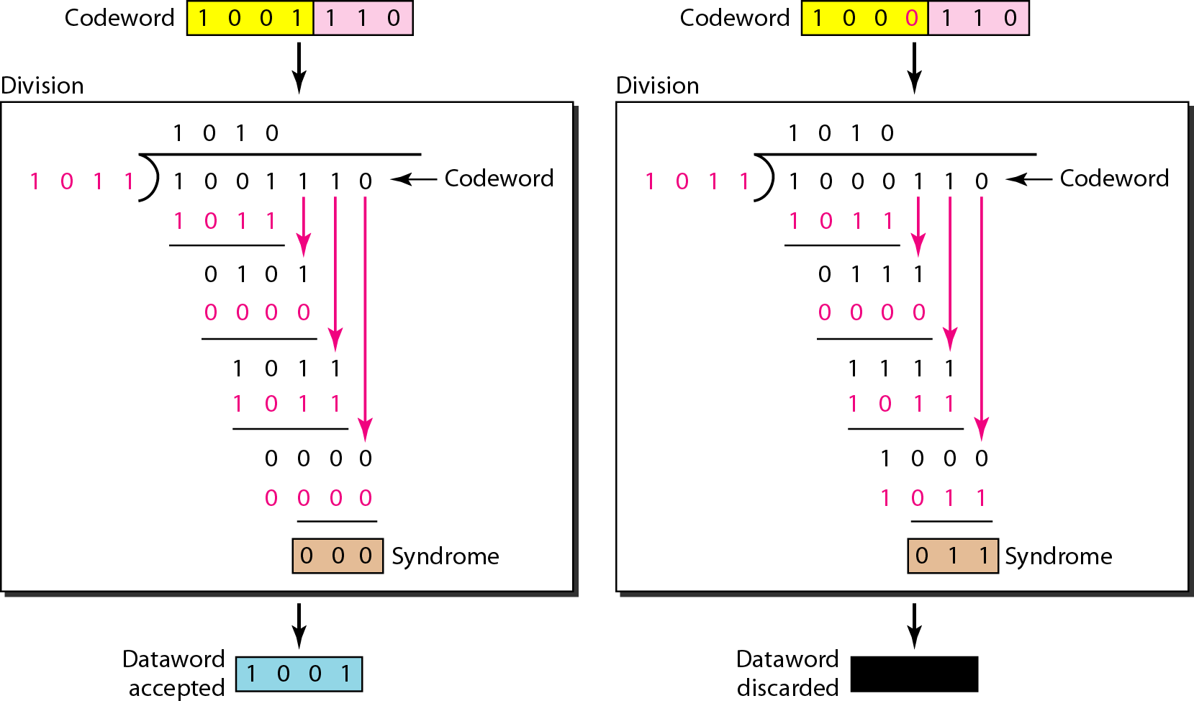
Solution
Division in the CRC decoder for two cases

Slide 12
Using Polynomials
We can use a polynomial to represent a binary word.
Each bit from right to left is mapped onto a power term.
The rightmost bit represents the “0” power term. The bit next to it the “1” power term, etc.
If the bit is of value zero, the power term is deleted from the expression.

Slide 13
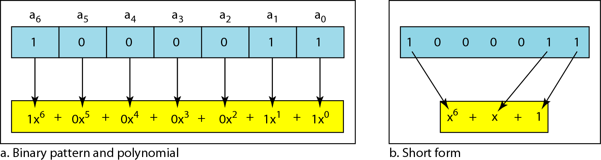
A polynomial to represent a binary word
Figure 10.21

Slide 14
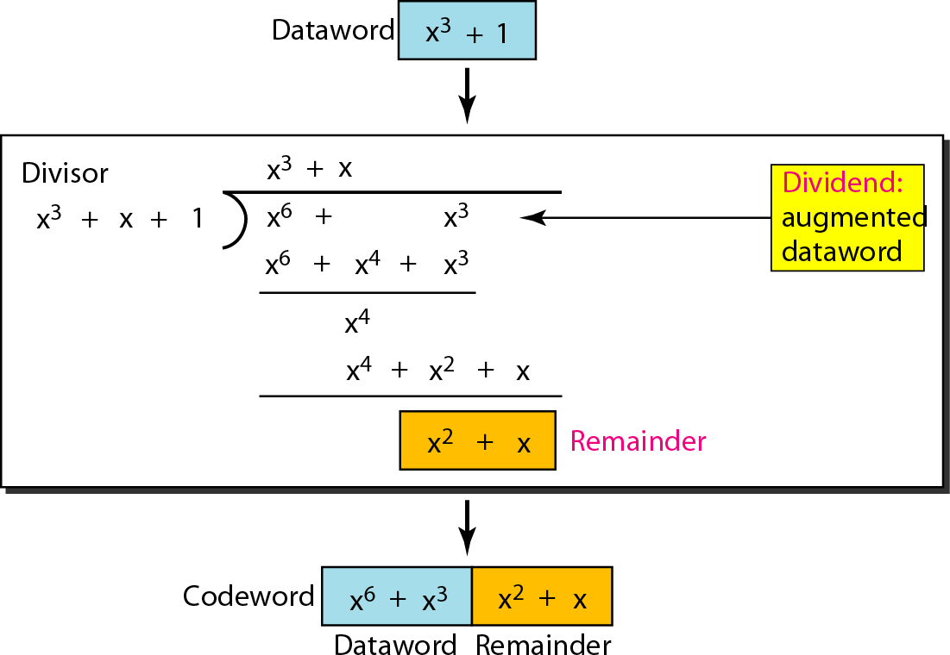
Figure 10.22 CRC division using polynomials

Slide 15
Note
The divisor in a cyclic code is normally called the generator polynomial
or simply the generator.

Slide 16
In a cyclic code,
If s(x) ≠ 0, one or more bits is corrupted. If s(x) = 0, either
Note
No bit is corrupted. or
Some bits are corrupted, but the decoder failed to detect them.

Slide 17
Example
Which of the following g(x) values guarantees that a single-bit error is caught? For each case, what is the error that cannot be caught?
a. x + 1 b. x³ c. 1
Solution
No x^{i} can be divisible by x + 1. Any single-bit error can be caught.
If i is equal to or greater than 3, x^{i} is divisible by g(x). All single-bit errors in positions 1 to 3 are caught.
All values of i make x^{i} divisible by g(x). No single-bit error can be caught. This g(x) is useless.

Slide 18
Note
If a generator cannot divide x^{t} + 1 (t between 0 and n – 1),
then all isolated double errors can be detected.

Slide 19
Example
Find the status of the following generators related to two isolated, single-bit errors.
a. x + 1 b. x⁴ + 1 c. x⁷ + x⁶ + 1 d. x¹⁵ + x¹⁴ + 1
Solution
This is a very poor choice for a generator. Any two errors next to each other cannot be detected.
This generator cannot detect two errors that are four positions apart.
This is a good choice for this purpose.
This polynomial cannot divide x^{t} + 1 if t is less than 32,768. A codeword with two isolated errors up to 32,768 bits apart can be detected by this generator.

Slide 20
Note
A generator that contains a factor of
x + 1 can detect all odd-numbered errors.

Slide 21
Example
Find the suitability of the following generators in relation to burst errors of different lengths.
a. x⁶ + 1 b. x¹⁸ + x⁷ + x + 1 c. x³² + x²³ + x⁷ + 1
Solution
a. This generator can detect all burst errors with a length less than or equal to 6 bits; 3 out of 100 burst errors with length 7 will slip by; 16 out of 1000 burst errors of length 8 or more will slip by.

Slide 22
Example
b. This generator can detect all burst errors with a length less than or equal to 18 bits; 8 out of 1 million burst errors with length 19 will slip by; 4 out of 1 million burst errors of length 20 or more will slip by.
c. This generator can detect all burst errors with a length less than or equal to 32 bits; 5 out of 10 billion burst errors with length 33 will slip by; 3 out of 10 billion burst errors of length 34 or more will slip by.

Slide 23
A good polynomial generator needs to have the following characteristics:
Note
It should have at least two terms.
The coefficient of the term x⁰ should be 1.
It should not divide x^{t} + 1, for t
between 2 and n − 1.
It should have the factor x + 1.

Slide 24
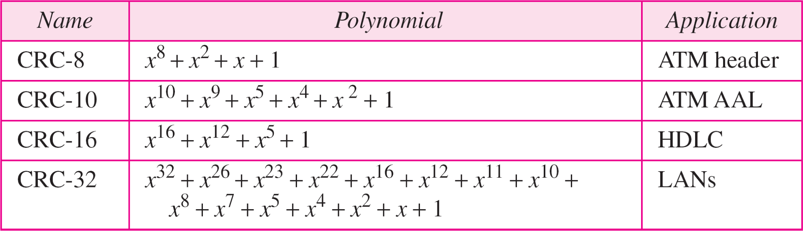
Table 10.7 Standard polynomials

Slide 25
7-5 CHECKSUM
The error detection method used by most TCP/IP protocols is called the checksum. The checksum protects against the corruption that may occur during the transmission of a packet. It is redundant information added to the packet. The checksum is calculated at the sender and the value obtained is sent with the packet. The receiver repeats the same calculation on the whole packet including the checksum. If the result is satisfactory (see below), the packet is accepted; otherwise, it is rejected.

Slide 26

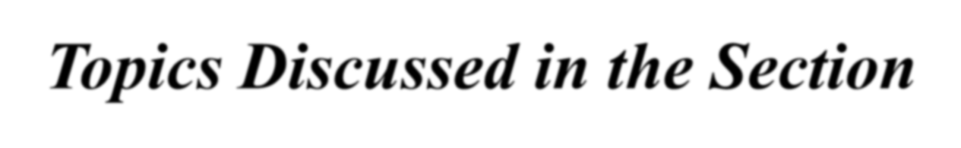
Topics Discussed in the Section
Checksum Calculation at the Sender
Checksum Calculation at the Receiver
Checksum in the Packet

Slide 27



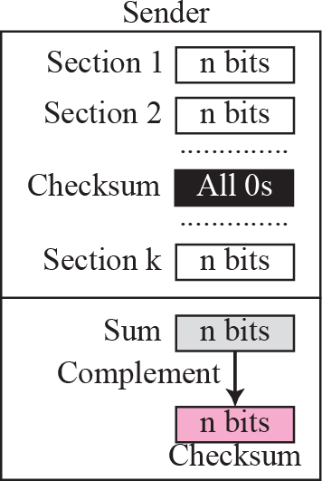
Figure 7.22
Checksum concept
Receiver
Section 1
Section 2
n bits
n bits
..............
Checksum
n bits
..............
Checksum
Section k
n bits
n bits
Packet
Sum
n bits
Complement
If the result is 0, keep;
n bits
otherwise, discard.
Result

Slide 28
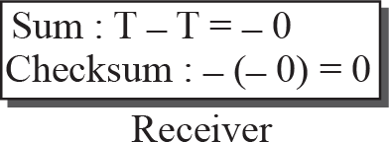
Figure 7.23
Checksum in one’s complement arithmetic
Sum : T
Checksum : _T
__{T}
T
Sender
Datagram

Slide 29
Note
Checksum in IP covers only the header, not the data.

Slide 30
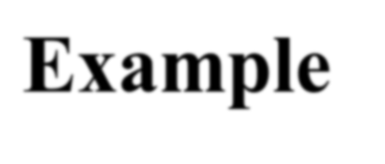
Example 7.17
Figure 7.24 shows an example of a checksum calculation at the sender site for an IP header without options. The header is divided into 16-bit sections. All the sections are added and the sum is complemented. The result is inserted in the checksum field.

Slide 31
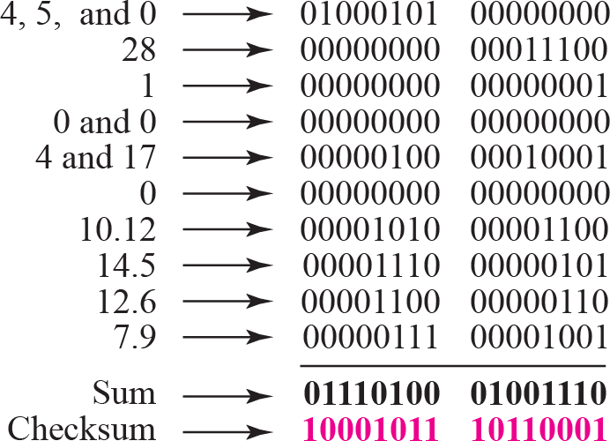
Figure 7.24
Example of checksum calculation at the sender
5 |  | 0
1 |  |  | 0
 | 17
10.12.14.5 12.6.7.9

Slide 32
Example 7.18
Figure 7.25 shows the checking of checksum calculation at the receiver site (or intermediate router) assuming that no errors occurred in the header. The header is divided into 16-bit sections. All the sections are added and the sum is complemented. Since the result is 16 0s, the packet is accepted.

Slide 33
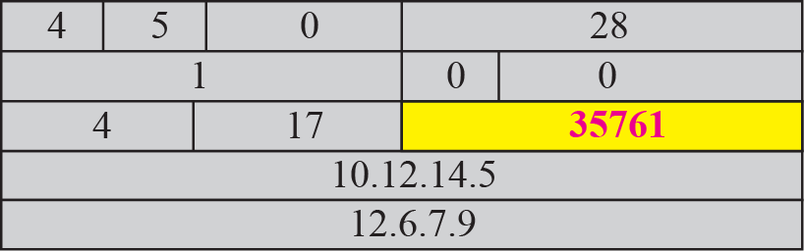
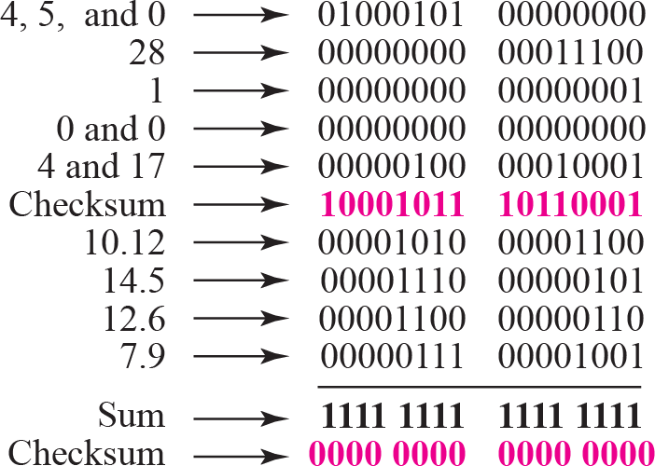
Figure 7.25
Example of checksum calculation at the receiver

Slide 34













































10-5 CHECKSUM
The last error detection method we discuss here is called the checksum. The checksum is used in the Internet by several protocols although not at the data link layer. However, we briefly discuss it here to complete our discussion on error checking
Idea
One’s Complement Internet Checksum

Slide 35
Example
Suppose our data is a list of five 4-bit numbers that we want to send to a destination. In addition to sending these numbers, we send the sum of the numbers.
For example, if the set of numbers is (7, 11, 12, 0, 6),
we send (7, 11, 12, 0, 6, 36), where 36 is the sum of the original numbers.
The receiver adds the five numbers and compares the result with the sum.
If the two are the same, the receiver assumes no error, accepts the five numbers, and discards the sum. Otherwise, there is an error somewhere and the data are not accepted.

Slide 36
Example
We can make the job of the receiver easier if we send the negative (complement) of the sum, called the checksum. In this case, we send (7, 11, 12, 0, 6, −36).
The receiver can add all the numbers received (including the checksum).
If the result is 0, it assumes no error; otherwise, there is an error.

Slide 37
Example
How can we represent the number 21 in one’s complement arithmetic using only four bits?
Solution
The number 21 in binary is 10101 (it needs five bits).
We can wrap the leftmost bit and add it to the four rightmost bits.
We have (0101 + 1) = 0110 or 6.

Slide 38
Example
How can we represent the number −6 complement arithmetic using only four bits?
Solution
In one’s complement arithmetic, the
in one’s
negative or
complement of a number is found by inverting all bits. Positive 6 is 0110; negative 6 is 1001.
If we consider only unsigned numbers, this is 9. In other words, the complement of 6 is 9.
Another way to find the complement of a number in one’s complement arithmetic is to subtract the number from 2^{n} − 1 (16 − 1 in this case).

Slide 39
Example2
Let us redo previous Exercise using one’s complement arithmetic. Next Figure shows the process of internet checksum at the sender and at the receiver.
The sender initializes the checksum to 0 and adds all data items and the checksum (the checksum is considered as one data item and is shown in color). The result is 36.
However, 36 cannot be expressed in 4 bits. The extra two bits are wrapped and added with the sum to create the wrapped sum value 6.
The sum is then complemented, resulting in the checksum value
9, (15 − 6 = 9).
The sender now sends six data items to the receiver including the checksum 9.

Slide 40
Example 2 (continued)
The receiver follows the same procedure as the sender. It adds all data items (including the checksum); the result is 45.
The sum is wrapped and becomes 15.
The wrapped sum is complemented and becomes 0. Since the value of the checksum is 0, this means that the data is not corrupted.
The receiver drops the checksum and keeps the other data items.
If the checksum is not zero, the entire packet is dropped.

Slide 41
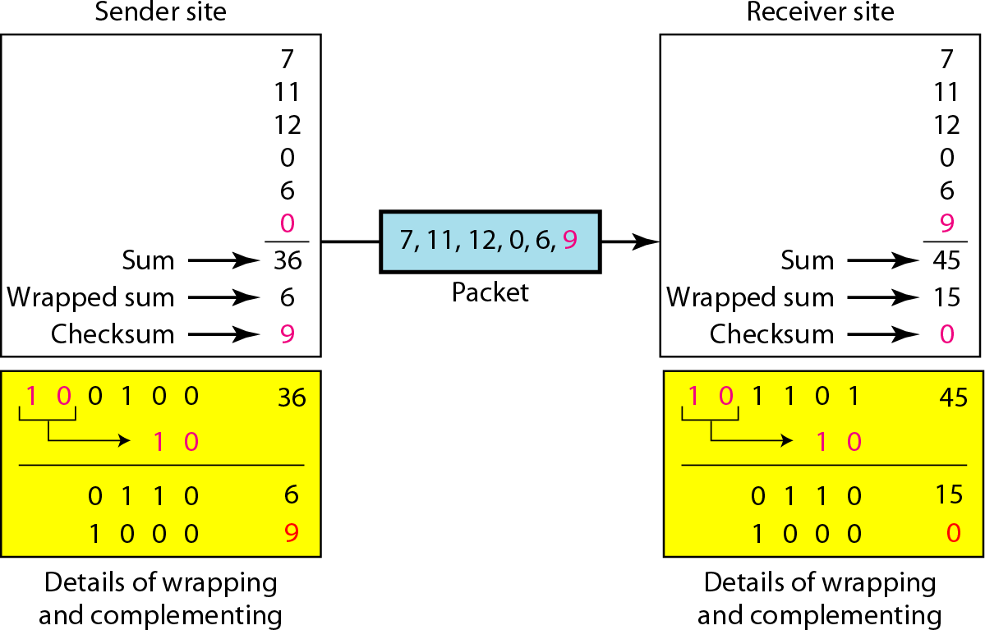
Solution Example 2

Slide 42
Sender site:
Note
The message is divided into 16-bit words.
The value of the checksum word is set to 0.
All words including the checksum are added using one’s complement addition.
The sum is complemented and becomes the checksum.
The checksum is sent with the data.

Slide 43
Receiver site:
Note
The message (including checksum) is divided into 16-bit words.
All words are added using one’s complement addition.
The sum is complemented and becomes the new checksum.
If the value of checksum is 0, the message is accepted; otherwise, it is rejected.

Slide 44
Example 3
Let us calculate the checksum for a text of 8 characters (“Forouzan”).
The text needs to be divided into 2-byte (16-bit) words.
Use ASCII to change each byte to a 2-digit hexadecimal number.
For example, F is represented as 0x46 and o is represented as 0x6F.
Figure shows how the checksum is calculated at the sender and receiver sites.
In part a of the figure, the value of partial sum for the first column is 0x36. We keep the rightmost digit (6) and insert the leftmost digit (3) as the carry in the second column. The process is repeated for each column.
Note that if there is any corruption, the checksum recalculated by the receiver is not all 0s.

Slide 45
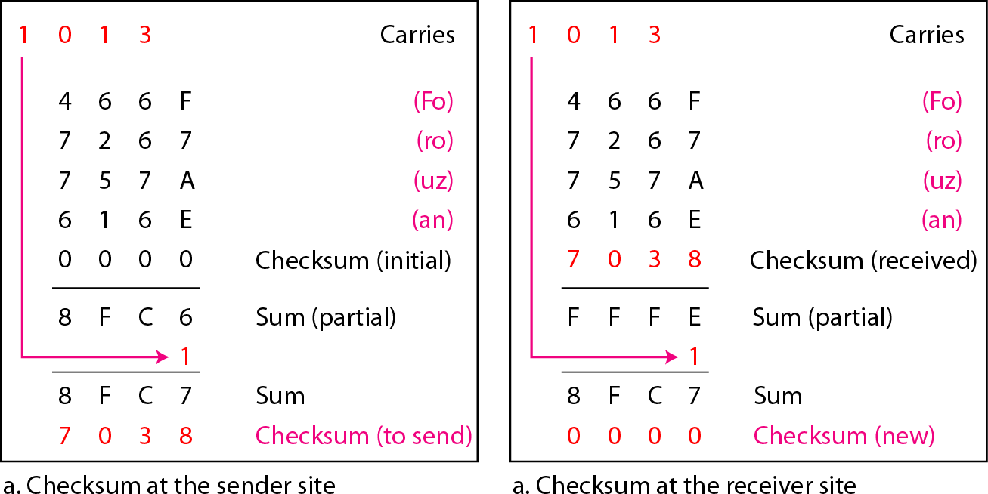
Solution
Example 3

